Slide 2
Chapter 17:1-5
Foundation Scripture

Slide 3
Then He said to the disciples, "It is impossible that no offenses should come, but woe to him through whom they do come! It would be better for him if a millstone were hung around his neck, and he were thrown into the sea, than that he should offend one of these little ones. Take heed to yourselves. If your brother sins against you, rebuke him; and if he repents, forgive him. And if he sins against you seven times in a day, and seven times in a day returns to you, saying, 'I repent,' you shall forgive him." And the apostles said to the Lord, "Increase our faith."

Slide 4
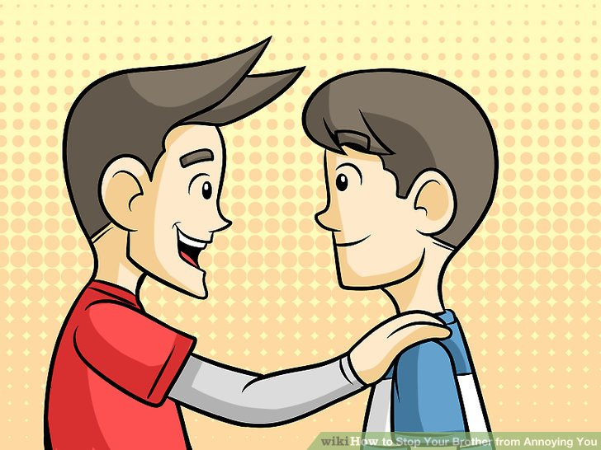
If Your Brother Offends You
Wednesday, March 18, 2020

Slide 5
Chapter 18:15-17
Scripture Lesson

Slide 6
“If your brother sins against you, go and tell him his fault, between you and him alone. If he listens to you, you have gained your brother. But if he does not listen, take one or two others along with you, that every charge may be established by the evidence of two or three witnesses. If he refuses to listen to them, tell it to the church. And if he refuses to listen even to the church, let him be to you as a Gentile and a tax collector.

Slide 7
Four Steps:
In Private
With Witness
Before the Church
Treat one as an Outsider

Slide 8
Now you are the body of Christ and individually members of it.
I Corinthians 12:27

Slide 9
So we, though many, are one body in Christ, and individually members one of another.
Romans 12:5

Slide 10
Therefore, having put away falsehood, let each one of you speak the truth with his neighbor, for we are members one of another.
Ephesians 4:25

Slide 11
The Bible Presents Two Ways To Maintain Unity

Slide 12
LOVING ONE ANOTHER
A new commandment I give to you, that you love one another: just as I have loved you, you also are to love one another. By this shall all men know that you are my disciples if you have love one for another.
John 13:34-35

Slide 13
LIVING IN PEACE WITH ONE ANOTHER
Live in harmony with one another… If possible, so far as it depends on you, live peaceably with all.
Romans 12:16,18

Slide 14
What To Do When We Offend One Another:

Slide 15
1. Overlook A Fault If You Can
Good sense makes one slow to anger, and it is his glory to overlook an offense.
Proverbs 19:11

Slide 16
2. Go To The Person Who Offended You
“If your brother sins against you, go and tell him his fault, between you and him alone.
Matthew 18:17

Slide 17
3. Minimize Public Awareness
We are to go to the person privately first.
”If your brother sins against you, go and tell him his fault, between you and him alone.
Matthew 18:15a

Slide 18
Let’s Examine Two Questions:

Slide 19
1. If Jesus commands us to go to our brother when he offends us, why is it so difficult to do?

Slide 20
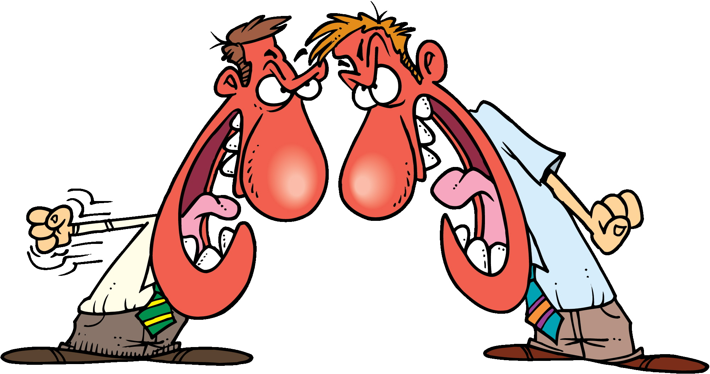
Answer: Hatred of Conflict and Fear

Slide 21
“Perfect Love Casts Out Fear.”
There is no fear in love, but perfect love casts out fear. For fear has to do with punishment, and whoever fears has not been perfected in love.
I John 4:18

Slide 22
2. What Should My Friend Do If I Bring My Offense To Him Instead Of Taking It To The Person Who Offended Me?

Slide 23
Answer: Encourage Me To Go To The Person

Slide 24
“In the middle of every difficulty, lies opportunity.”
Albert Einstein

Slide 25
“It is how we handle conflict that determines the level of our spiritual maturity”
Larry Crabb

Slide 26
“Coping with difficult people is always a problem. Especially if the difficult person happens to be yourself.”
John Maxwell

